Slide 1
Structural models
Display the organization of a system in terms of the components that make up that system and their relationships.
2 types of structural models (we do both):
Static models: show the structure of the system design,
  Class, component, package, deployment diagrams
Dynamic models: show the organization of the system when it is executing.
Create structural models of a system when you are discussing and designing the system architecture.
Chapter 5 System modeling
1

Slide 2
Class diagrams
Class diagrams are used when developing an object-oriented system model to show the classes in a system and the associations between these classes.
An object class can be thought of as a general definition of one kind of system object.
An association is a link between classes that indicates that there is some relationship between these classes.
When you are developing models during the early stages of the software engineering process, objects represent something in the real world, such as a patient, a prescription, doctor, etc.
Chapter 5 System modeling

Slide 3

UML classes and association
There are 2 classes: Patient and Patient Record
No detail yet, early in the analysis
Patient is associated with patient record
i.e. for each patient there is a patient record
i.e. every patient record is associated with a patient
Chapter 5 System modeling

Slide 4
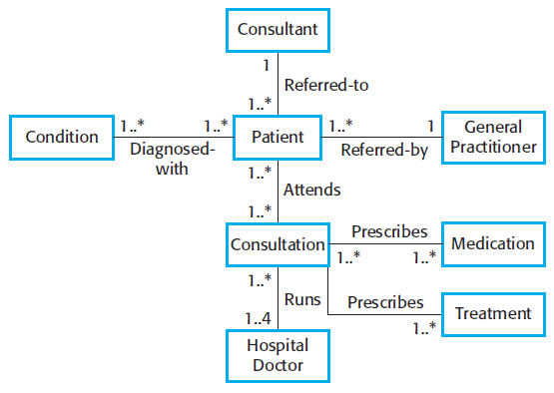
Classes and associations in the MHC-PMS
multiplicity
Name of the association
For better reading
Chapter 5 System modeling

Slide 5
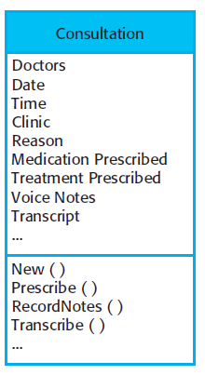
The Consultation class
Detailing a class
Class NAME
Attributes
(characteristics of an object)
Services (or operations)
(things that you can request
from an object)
Chapter 5 System modeling

Slide 6
Generalization
In modeling systems, it is often useful to examine the classes in a system to see if there is scope for generalization.
If changes are proposed, then you do not have to look at all classes in the system to see if they are affected by the change.
In object-oriented languages (Java, C++), generalization is the class inheritance mechanisms built into the language.
Attributes and operations associated with higher-level classes are also associated with the lower-level classes.
The lower-level classes are subclasses inherit the attributes and operations from their superclasses.
These lower-level classes then add more specific attributes and operations.
Chapter 5 System modeling

Slide 7
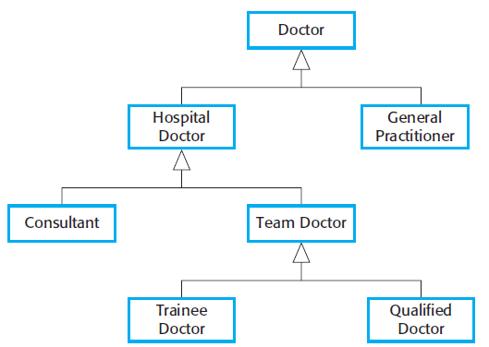
A generalization hierarchy
generalization
Chapter 5 System modeling

Slide 8
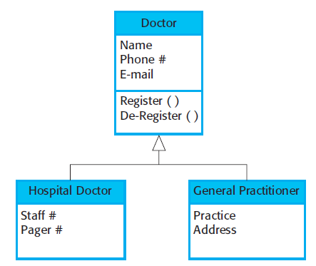
A generalization hierarchy with added detail
All doctors have a name,phone number, and email
All hospital doctors have a staff
number and a department but general practitioners don’t have these attributes as they
work independently. They do however, have a practice name and address
Chapter 5 System modeling

Slide 9
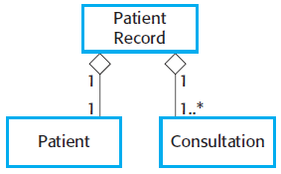
The aggregation association
An aggregation model shows how classes that are collections are composed of other classes.
  A class is composed of other classes
  Part-whole relationship
E.g. a patient record is composed of many consultation and a patient
Chapter 5 System modeling

Slide 10
Behavioral models
dynamic behavior of a system as it is executing.
They show what happens or what is supposed to happen when a system responds to a stimulus from its environment.
You can think of these stimuli as being of two types:
  Data Some data arrives that has to be processed by the system.
  Events Some event happens that triggers system processing. Events may have associated data, although this is not always the case.
Chapter 5 System modeling

Slide 11
Data-driven modeling
Many business systems are data-processing systems that are primarily driven by data.
  They are controlled by the data input to the system, with relatively little external event processing.
Data-driven models show the sequence of actions involved in processing input data and generating an associated output.
They are particularly useful during the analysis of requirements as they can be used to show end-to-end processing in a system.
DFD –not a part of UML
Chapter 5 System modeling

Slide 12
Data driven modelling in UML
DFDs are not part of UML since DFDs focus on system functions and do not recognize system objects.
However, because data-driven systems are so common in business, UML 2.0 introduced activity diagrams, which are similar to data-flow diagrams.
Sequence diagram are also used to show the sequence of processing.
  draw them so that messages are only sent from left to right, then they show the sequential data processing in the system
Activity diagram could also be used instead
Chapter 5 System modeling

Slide 13
Event-driven modeling
Real-time systems are often event-driven, with minimal data processing.
  For example, a landline phone switching system responds to events such as ‘receiver off hook’ by generating a dial tone.
Event-driven modeling shows how a system responds to external and internal events.
Based on the assumption that a system has a finite number of states and that events (stimuli) may cause a transition from one state to another.
  e,.g. a system controlling a valve may move from a state ‘Valve open’ to a state ‘Valve closed’ when an operator command (the stimulus) is received.
Chapter 5 System modeling

Slide 14
State machine models
UML has state diagrams for event-driven modelling
  Based on Statecharts (Harell87), similar to state machines
Model the behaviour of the system in response to external and internal events.
  often used for modelling real-time systems.
Notation:
  System states as nodes and events as arcs between these nodes.
  When an event occurs, the system moves from one state to another. (state transition)
  They do not show the flow of data within the system but may include additional information on the computations carried out in each state
Chapter 5 System modeling

Slide 15
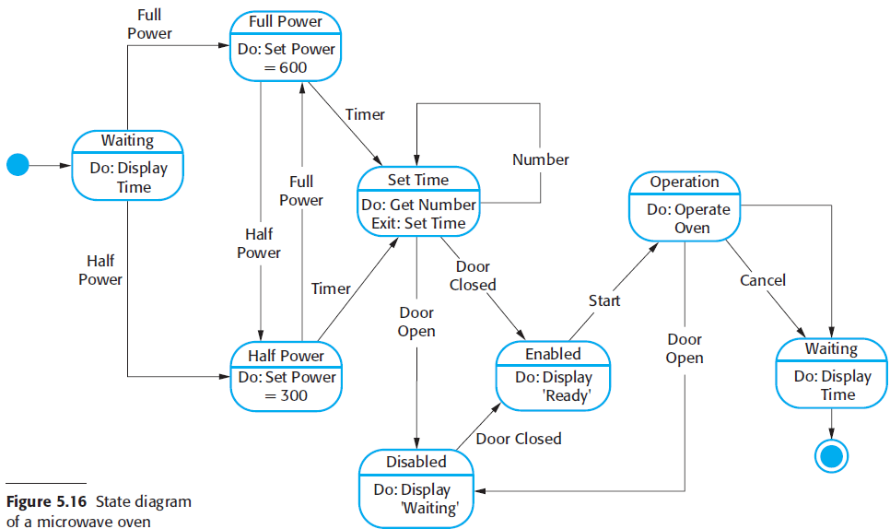
State diagram of a microwave oven
state
Do: actions taken in that state
Stimuli/event
Chapter 5 System modeling

Slide 16
States and stimuli for the microwave oven (a)
State | Description
Waiting | The oven is waiting for input. The display shows the current time.
Half power | The oven power is set to 300 watts. The display shows ‘Half power’.
Full power | The oven power is set to 600 watts. The display shows ‘Full power’.
Set time | The cooking time is set to the user’s input value. The display shows the cooking time selected and is updated as the time is set.
Disabled | Oven operation is disabled for safety. Interior oven light is on. Display shows ‘Not ready’.
Enabled | Oven operation is enabled. Interior oven light is off. Display shows ‘Ready to cook’.
Operation | Oven in operation. Interior oven light is on. Display shows the timer countdown. On completion of cooking, the buzzer is sounded for five seconds. Oven light is on. Display shows ‘Cooking complete’ while buzzer is sounding.
Chapter 5 System modeling

Slide 17
States and stimuli for the microwave oven (b)
Stimulus | Description
Half power | The user has pressed the half-power button.
Full power | The user has pressed the full-power button.
Timer | The user has pressed one of the timer buttons.
Number | The user has pressed a numeric key.
Door open | The oven door switch is not closed.
Door closed | The oven door switch is closed.
Start | The user has pressed the Start button.
Cancel | The user has pressed the Cancel button.
Chapter 5 System modeling

Slide 18
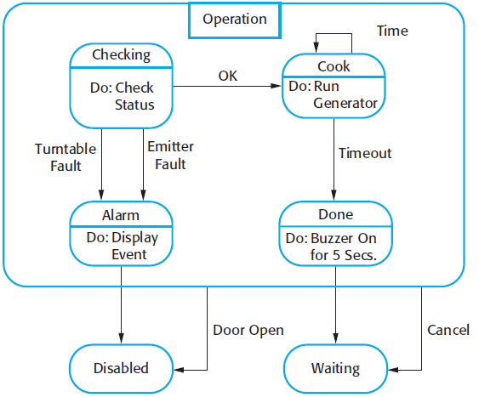
Microwave oven operation
the number of possible states increases rapidly.
Superstate
Chapter 5 System modeling

